Slide 1
AWS SERVICES
--CH.TARAKESWAR(20A31A0534)

Slide 2
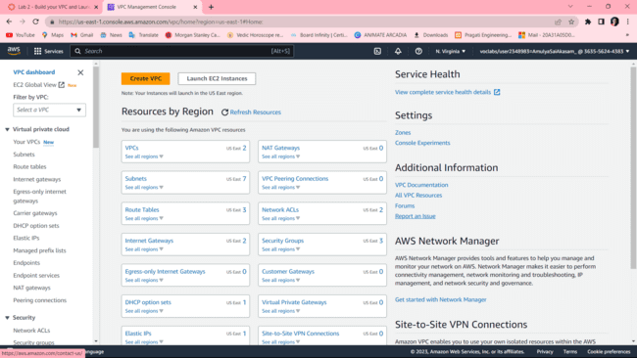
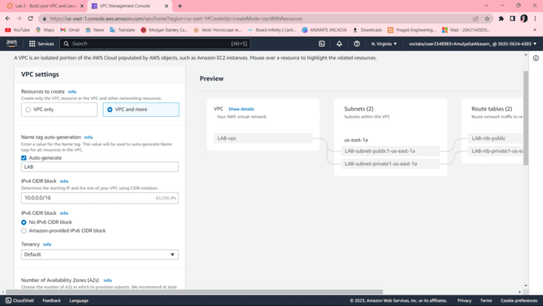
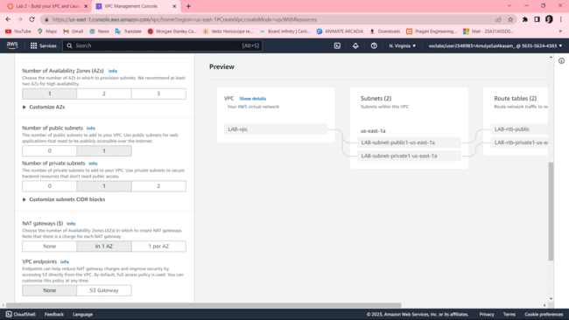
BUILDING A VPC AND LAUNCHING A WEB SERVER
Step 1: First start the lab, when the lab status gets ready, it redirects to the AWS management console.
Step 2: Go to AWS services, search, and choose VPC to open the VPC console.
Step 3: Verify that your regions remain in the N-Virginia(us-east-1). Choose to create VPC in the VPC dashboard
Step 4: Choose VPC and more, in name tag auto-generation, keep auto-generate select and change it to a lab.
Step 5: Keep the IPv4 CIDR block to 10.10.0.0.0/16 and next for a number of availability zones select 1, number of public subnets select 1 , number of private subnets select 1
Step 6: Now customize subnets CIDR blocks, change public subnet(us-east-1a) to 10.10.0.0/24, and change private subnet (us-east-1a) to 10.0.1.0/24
Step 7: Set the NAT gateways to 1AZ and set VPC endpoints to none and keep both DNS hostnames and DNS resolutions enabled
Step 8: Check on the preview panel on the right side whether they match with the given regions or not

Slide 3
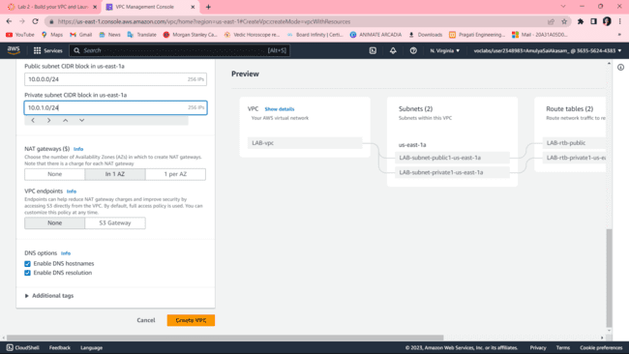
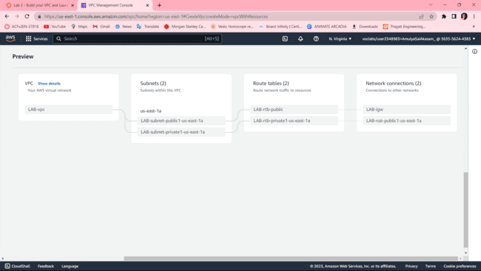
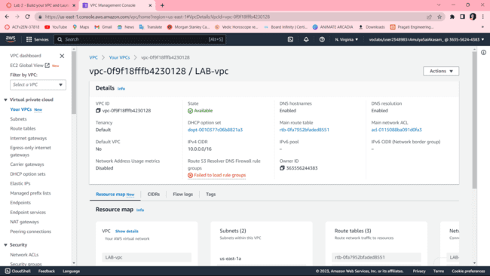
CREATING ADDITIONAL SUBNETS :
Step 1: Choose subnets in the left panel, choose to CREATE SUBNET
Step 2: in this, choose VPC ID: LAB-vpc and choose subnet name to lab-subnet-public2, choose availability sone to us-east-1b and choose IPv4 block to 10.0.2.0/24
Step 3: choose to create a subnet and again create the same subnet with lab-subnet-private2, change the IPv4 block to 10.0.2.0/24, and then create a subnet
Step 4: Choose the routing table in the left panel, select lab-rtb-private1-us-east-1a, in the lower panel, choose routes note destination, choose the subnet association tab, in the explicit subnet associations panel choose EDIT SUBNET ASSOCIATIONS
Step 5 : Leave lab-subnet-private1-us-east-1a and also select lab-subnet-private2
Step 6: Choose SAVE ASSOCIATIONS
Step 7: Select lab-rtb-public route table and deselect any other subnet
Step 8: In the lower panel, again repeat from step 4 but here we select lab-subnet-public2 also
Step 9: Choose SAVE ASSOCIATIONS

Slide 4
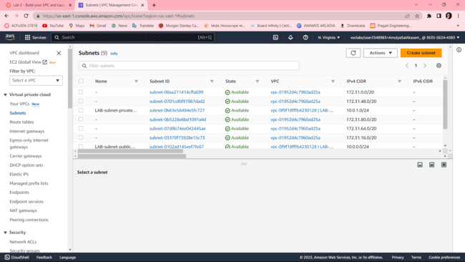
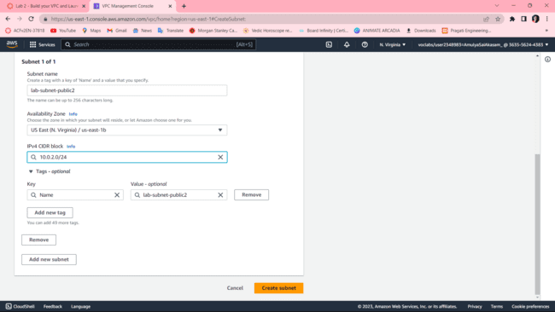
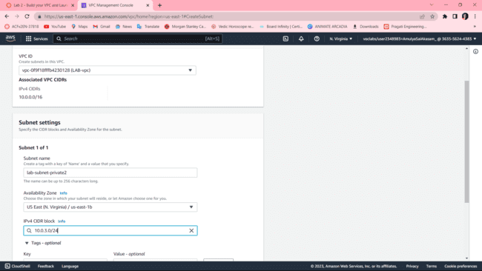
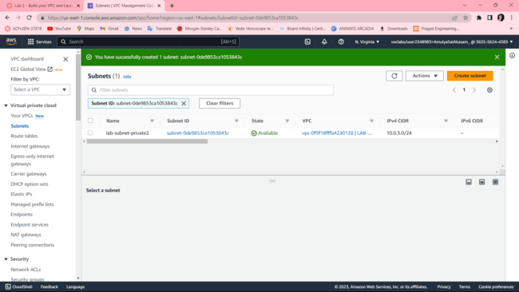
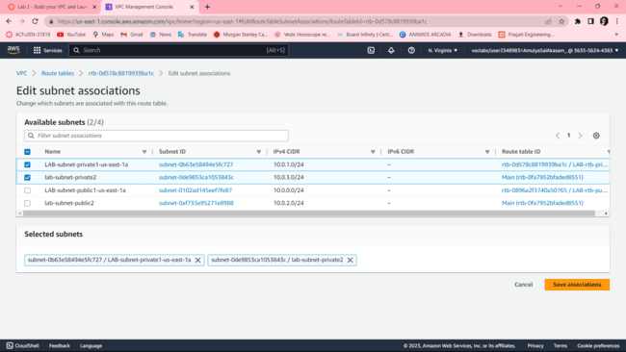
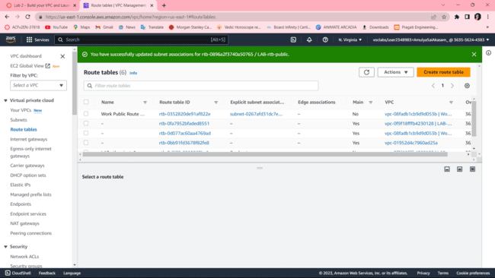

Slide 5
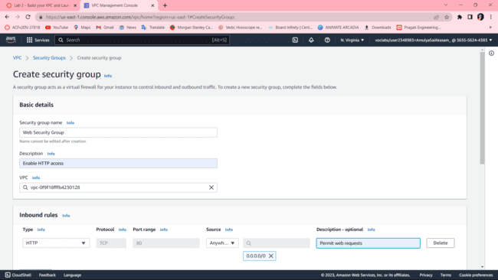
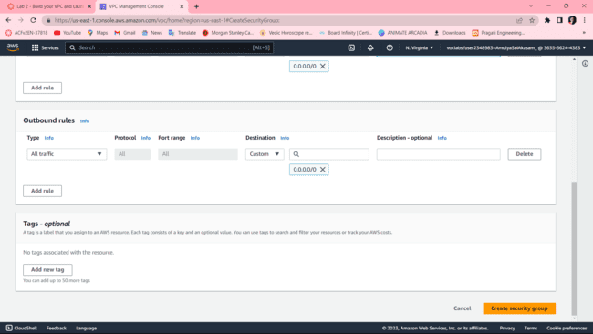
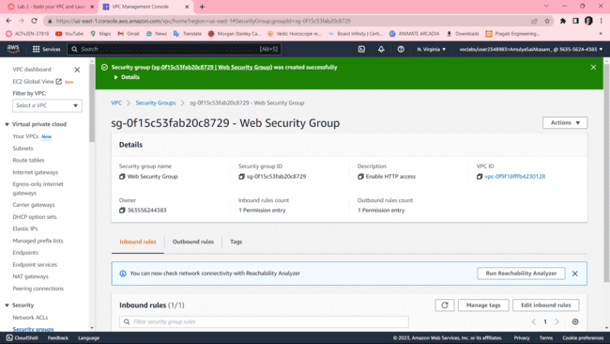
CREATING A VPC SECURITY GROUP
Step 1: Choose to create a security group and in this choose the security group name to a web security group, have a description as enable HTTP access and choose vpc to lab-vpc
Step 2: In inbound rules choose to add rule and then in this chosen type to HTTP, source to Anywhere ipv4 and description to permit web requests

Slide 6
LAUNCH A WEB SERVER INSTANCE
Step 1 : Choose EC2 to open EC2 console , from instances click launch instance and give name as web server 1
Step 2 : Keep Amazon Linux selelct and select amazon linux 2023 AMI , Choose t2.micro
Step 3 : Choose key pair name to vockey , in network settings choose edit select network to lab-vpc ,subnet to lab-subnet-public2 and auton assign to enable
Step 4 : Under firewall choose select existing security group , for common security groups select web security group
Step 5 : Expand the advanced details panel , scroll down upto the user data box appear
#!/bin/bash
# Install Apache Web Server and PHP
sudo dnf install -y httpd wget php mariadb105-server
# Download Lab files get https://aws-tc-largeobjects.s3.us-west-2.amazonaws.com/CUR-TF-100-ACCLFO-2-9026/2-lab2-vpc/s3/lab-app.zip
unzip lab-app.zip -d /var/www/html/
# Turn on web server
chkconfig httpd on
service httpd start
Step 6: At the bottom SUMMARY panel choose launch instance ,click on view instances
Step 7 : Wait until web server 1 shows 2/2 checks passed
Step 8 : Copy the public ipv4 dns value present in details tab
Step 9 : Open a new browser , copy the public dns
Step 10 : Finally we see a web page displaying AWS logo and instances meta-data values

Slide 7
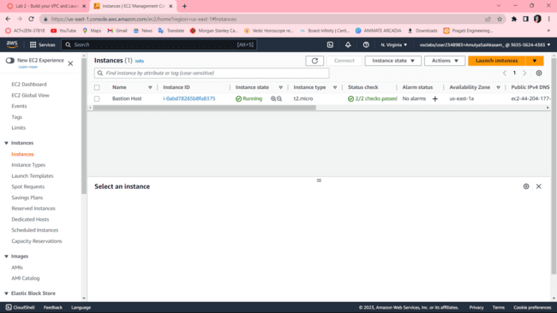
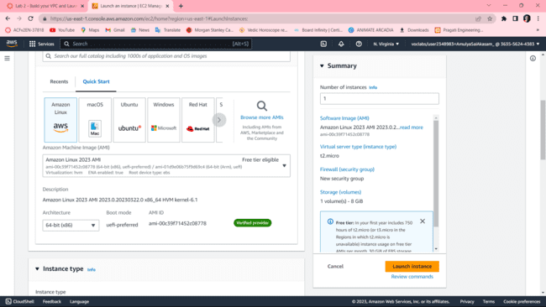
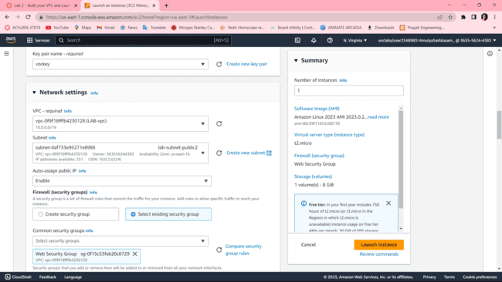
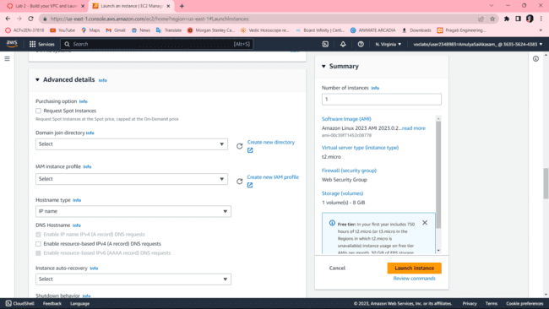
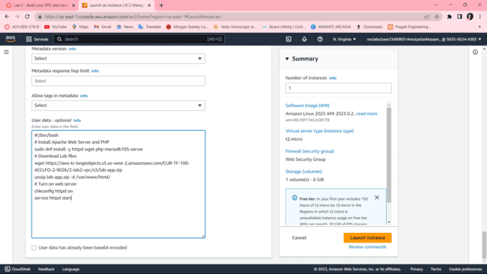
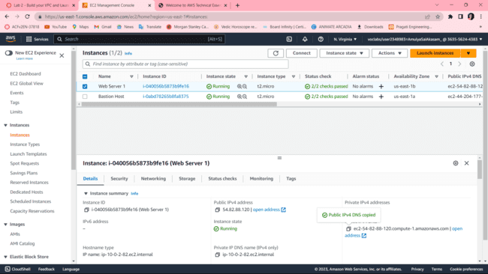

Slide 8
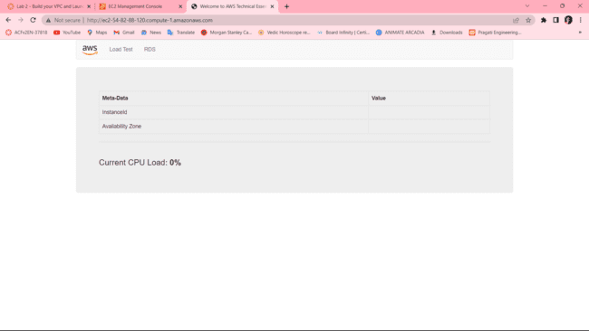
Finally, a web page opens displaying the AWS logo and instances of metadata values

Slide 9
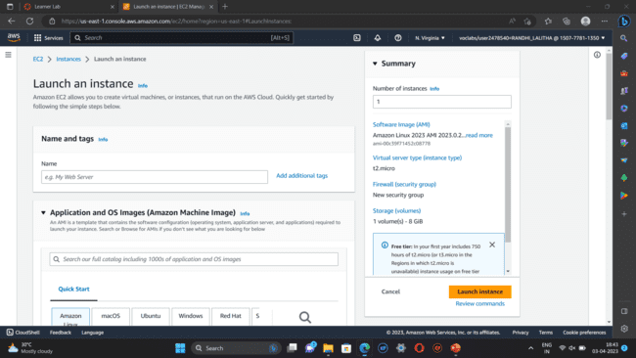
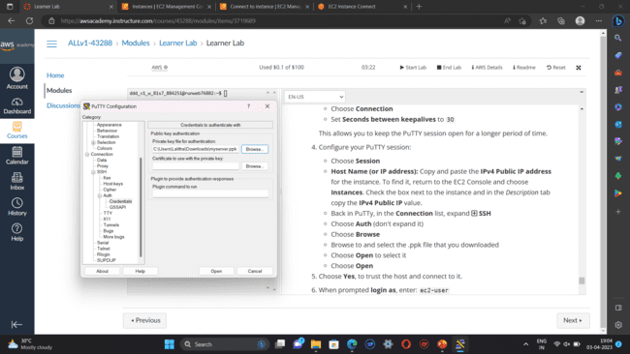
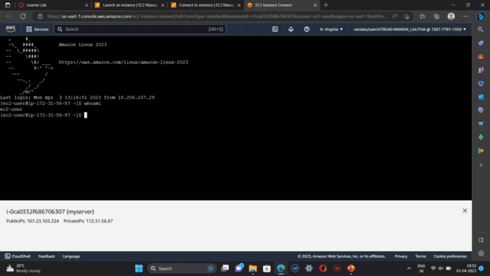
CREATING AN EC2 INSTANCE
Step-1: Go to AWS services , click EC2 and then select ‘launch instances’.
Step-2: Name the instance, select an AMI(LINUX,WINOWS server) , select a key pair and click launch instance.
Step-3: For linux-select ppk key and for windows server-select pem key.
Step-4: If a key pair is not available create a new key.
Step-5: For linux-click connect to instance you will be redirected to the CLI (or) open the putty file configure it to not timeout, and configure putty session. This will redirects you to the CLI.
For windows server-click connect🡪RDP client🡪 get password🡪 upload private key🡪 decrypt password. Open rdp file and enter the password. This will redirects you to the windows server.
Step-6: Terminate the instances .

Slide 10
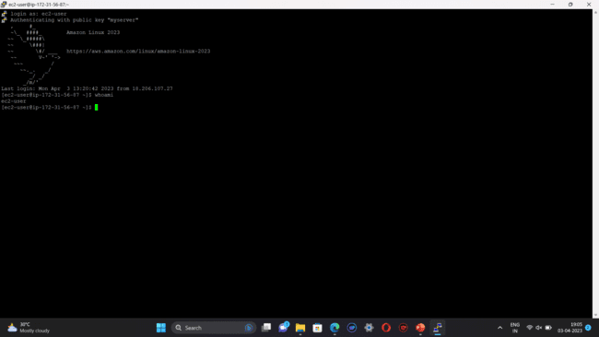
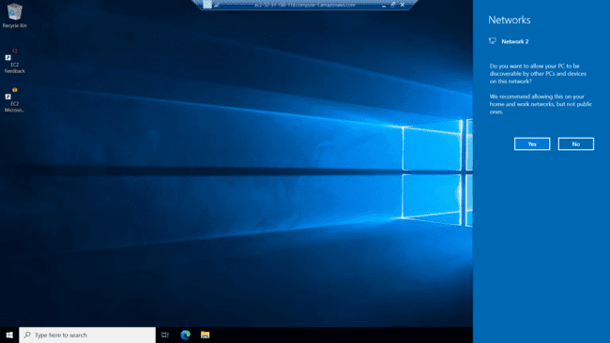
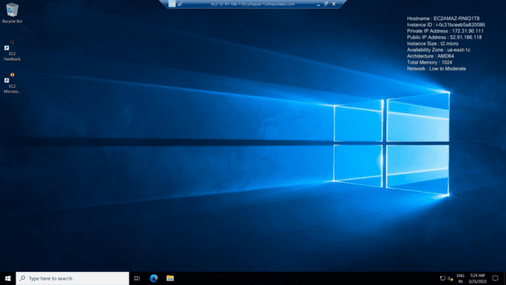
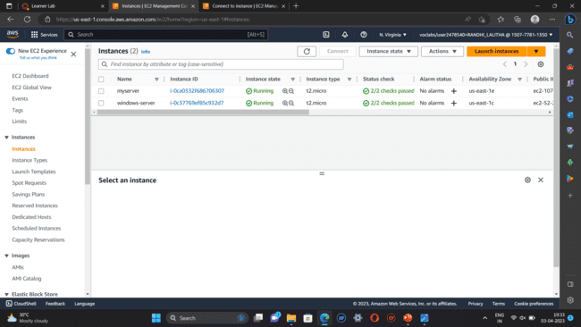

Slide 11
AMAZON LIGHT SAIL
PROCEDURE:
On the home page, choose Create instance.
Select a location for your instance (an AWS Region and Availability Zone). Choose Change Region and zone to create your instance in another location.
Optionally, you can change the Availability Zone. Choose an Availability Zone from the dropdown list.
Pick an application (Apps + OS) or an operating system (OS Only).
5. Choose your instance plan.
6. Enter a name for your instance.
Resource names:
Must be unique within each AWS Region in your Lightsail account.
Must contain 2 to 255 characters.
Must start and end with an alphanumeric character or number.
Can include alphanumeric characters, numbers, periods, dashes, and underscores.

Slide 12

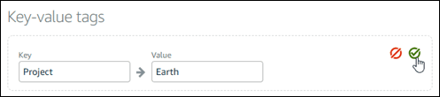
Choose one of the following options to add tags to your instance:
Add key-only tags or Edit key-only tags (if tags have already been added). Enter your new tag into the tag key text box, and press Enter. Choose Save when you’re done entering your tags to add them, or choose Cancel to not add them.
Create a key-value tag, then enter a key into the Key text box, and a value into the Value text box. Choose Save when you’re done entering your tags, or choose Cancel to not add them.Key-value tags can only be added one at a time before saving. To add more than one key-value tag, repeat the previous steps.
Choose Create instance.
Within minutes, your Lightsail instance is ready and you can connect to it via SSH, without leaving Lightsail!

Slide 13
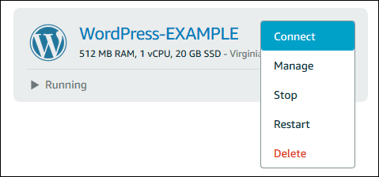
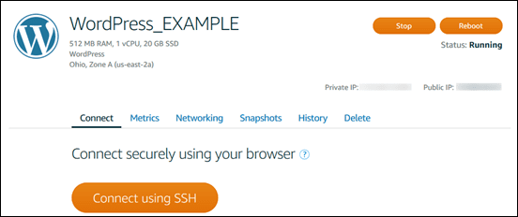
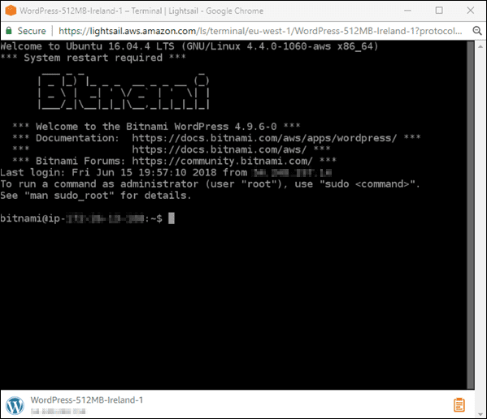
How to connect to your instance
1.From the Lightsail home page, choose the menu on the right of your instance's name, and then choose connect.
Alternately, you can open your instance management page and choose the Connect tab.
.You can now type commands into the terminal and manage your Lightsail instance without setting up an SSH client.

Slide 14
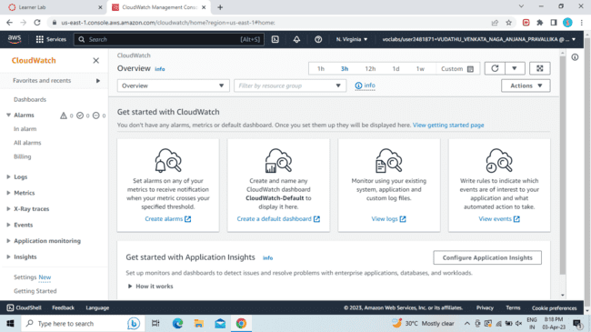
AWS CLOUD WATCH
PROCEDURE
1.Go to AWS Services, Click on CloudWatch, and then in the Dashboard go to the Alarms section and select Billings.
2.Then Click on CREATE ALARM.
3. Then follow the steps.
In the first step it will ask us to Specify metric and conditions.Click on Select Metric.
Change the Currency to Rupee.
4.In the Conditions, section choose the EstimatedCharges like Greater/GreaterEqual/Lowerequal/Lower and also define the threshold value.

Slide 15
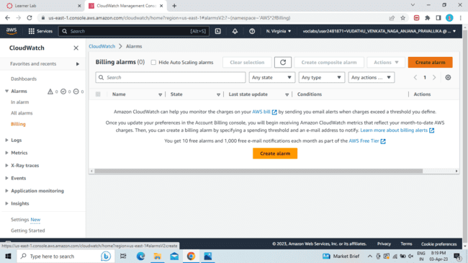
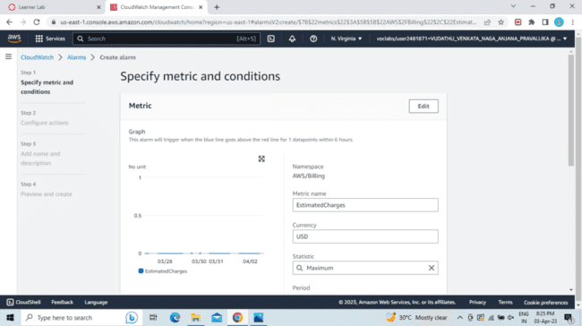
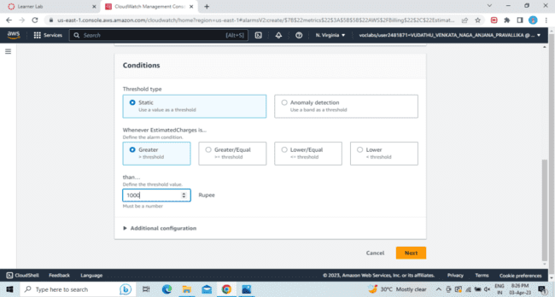
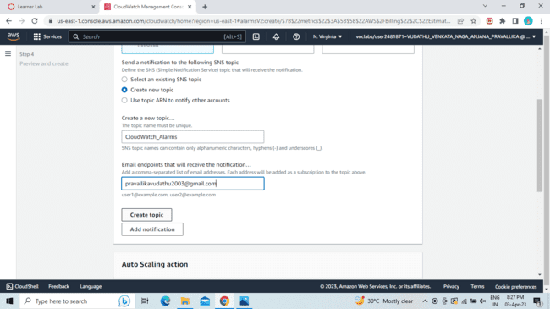
5.Now for Configure Actions choose to Create new topic. Give a name to the topic and enter your email to receive a notification. Click on Create Topic,then Next

Slide 16
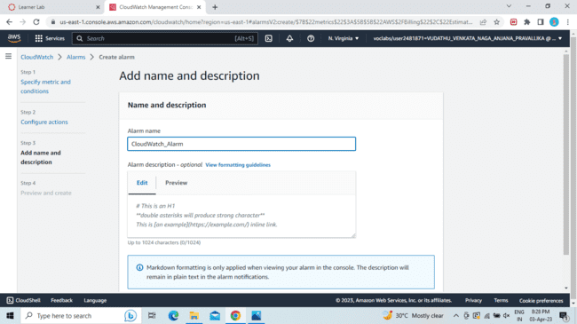
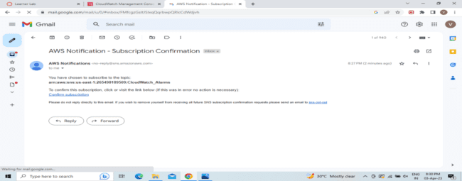
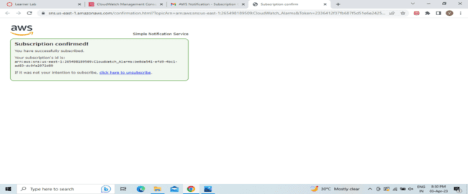
6.Give a name to your Alarm and Click on next.
7.You will get a AWS Notification-Subscription Confirmation mail to the email which you have provided. Click on Confirm Subscription.Then it will open a window showing Subscription Confirmed.

Slide 17
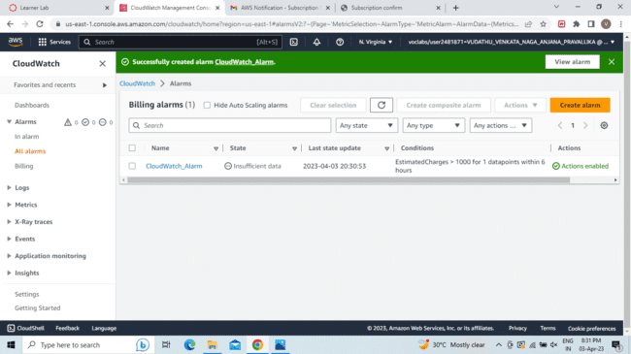
8.Preview the details you have entered .
9.Click on Create alarm.This will Create your Alarm.

Slide 18
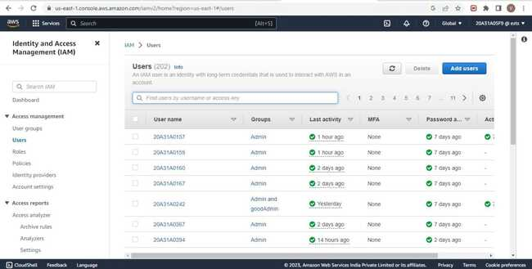
AWS COMMAND LINE INTERFACE
Step 1 - Download and install AWS CLI and complete the installation steps.
Step 2 - Login to AWS Management Console and search for IAM.
Step 3 - In the navigation pane , select Users

Slide 19
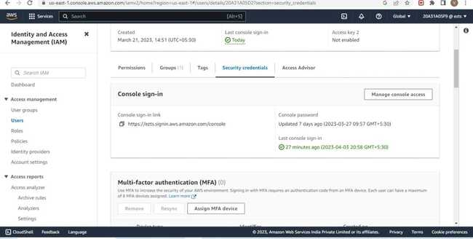
Step 4 - In the users select the name of the user whose access keys you want to create.
Step 5 – Click on the Security Credentials tab.
Step 6 - In the access Keys section , choose Create access key.

Slide 20
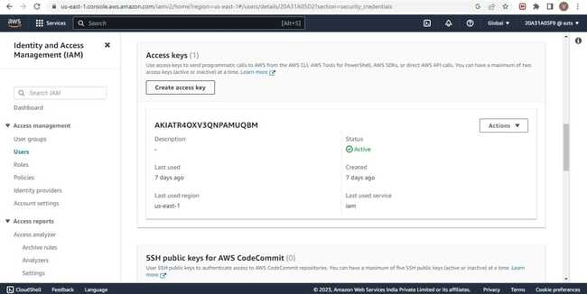
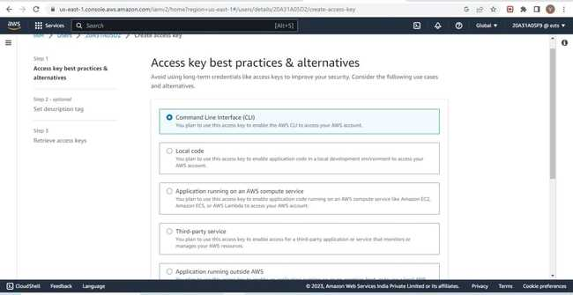
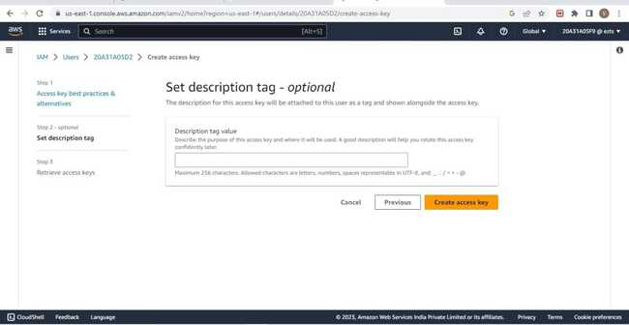
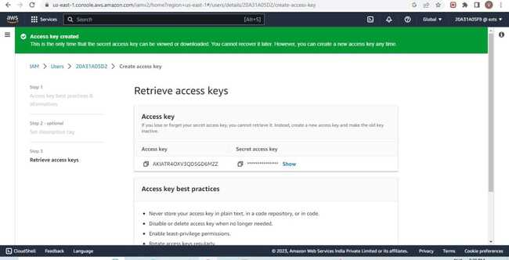

Slide 21

Step 6 – Now you can use this access key to configure CLI
Step 7 - Open Command Line Interface and run the following command
>aws configure
After entering this command AWS CLI prompts us with four pieces of information
1. Access Key ID: (enter your ID)
2.Secret Access Key: ( enter your key)
3.AWS Region: (enter the desired region )
4.Output Format: (enter the desired output)
Finally we get Javascript Object Notation of all the users as output

Slide 22
CREATING A EBS VOLUME
Open Management Console, on the services menu, open Ec2
In the left navigation pane choose instances and create an instance with a name
Next, In the left navigation pane choose Volumes
Click on Create Volume
Select volume type, size(Gib), and Availability Zone, and in Add tag section add key and value names.
Then click on create volume
Click on volumes on the left navigation pane select the created volume and attach a previously created instance to it.
Download the ppk file
Then, go to the “Details” drop-down, choose “show”
Download putty
Open putty set the fields (such as Host name, public key, private key) as per the requirement.
The putty shell will open, then login into it and run the commands.
The commands look like: df –h
sudo mkfs –t ext3/dev/sdf etc.,
14. Create an EBS snapshot by giving the necessary fields.
15. Create a volume using a snapshot.
16. Attach the volume to the created EC2 instance

Slide 23
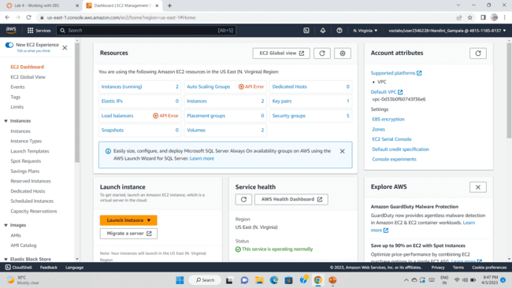
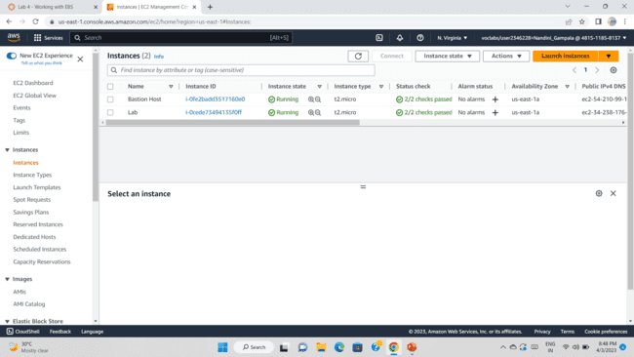



Slide 24





Slide 25





Slide 26


SETTING UP AMAZON DYNAMO DB
1. Setting up the Amazon DynamoDB
2. Here, we will be having a JSON file which is a product catalog
3. The products have a lot of different attributes and it is only common.
4.The interface looks like this:

Slide 27



5. After creating the table, we can see that there are no items present.
6.So we will use the CLI to populate the table. Open PowerShell of AWS.

Slide 28



Slide 29


AWS RDS
Step 1: Create a Security Group for the RDS DB Instance.
AWS management console 🡪 vpc 🡪 security groups 🡪 choose to create security group 🡪 and add an inbound rule 🡪 to create a security group.

Slide 30


Step 2 : Create a DB Subnet Group.Rds 🡪 subnet groups 🡪 choose create DB subnet group 🡪 add subnets 🡪 create DB subnet group.
Step 3: In the left navigation pane, choose Databases 🡪 choose create database 🡪 MYSQL

Slide 31


Step 4: In Availability and durability, choose Multi–AZ DB instance then configure settings, DB instance class, Storage, connectivity, choose existing vpc security group, and set up additional configuration.

Slide 32


Step 5: Wait until Info changes to Modifying or Available.
Scroll down to the Connectivity & security section and copy the Endpoint field.

Slide 33



Step 6 : Interact with Your Database.
On Details , copy the WebServer IP address. Open a new web browser tab, paste the WebServer IP address and press Enter.
The web application will be displayed, showing information about the EC2 instance.

Slide 34


Step 7 : Choose the RDS link at the top of the page and configure the settings.
Step 8: After a few seconds the application will display an Address Book.
The Address Book application is using the RDS database to store information.

Slide 35
AWS LAMBDA
1.In the search box to the right of Services, search for and choose Lambda to open the AWS Lambda console.
2.Choose Create function.
3.In the Create function screen, configure these settings:
>Choose Author from scratch
>Function name: myStopinator
>Runtime: Python 3.8
>Choose Change default execution role
>Execution role: Use an existing role
>Existing role: From the dropdown list, choose myStopinatorRole
4.Choose Create function.
5. Choose Add trigger.
6.Choose the Select a trigger dropdown menu, and select EventBridge (CloudWatch Events).
7.For the rule, choose Create a new rule and configure these settings:
Rule name: everyMinute
Rule type: Schedule expression
Schedule expression: rate(1 minute)
8. Choose Add.

Slide 36
Below the Function overview pane, choose Code, and then choose lambda_function.py to display and edit the Lambda function code.
In the Code source pane, delete the existing code. Copy the following code, and paste it in the box:
import boto3
region = '<REPLACE_WITH_REGION>'
instances = ['<REPLACE_WITH_INSTANCE_ID>']
ec2 = boto3.client('ec2', region_name=region)
def lambda_handler(event, context):
ec2.stop_instances(InstanceIds=instances)
print('stopped your instances: ' + str(instances))
9.Replace the <REPLACE_WITH_REGION> placeholder with the actual Region that you are using. To do this:
10.Choose on the region on the top right corner and use the region code. For example, the region code for US East (N.Virginia) is us-east-1.
11.Verify that an EC2 instance named instance1 is running in your account, and copy the instance1 instance ID.
12.Return to the AWS Lambda console browser tab, and replace <REPLACE_WITH_INSTANCE_ID> with the actual instance ID that you just copied.
13.Choose the File menu and Save the changes. Then, in the top-right corner of the Code source box, choose Deploy.
14.Choose Monitor
15.Return to the Amazon EC2 console browser tab and see if your instance was stopped.

Slide 37




Slide 38


ELASTIC LOAD BALANCER(ELB)
Elastic Load Balancing automatically distributes incoming application traffic across multiple Amazon EC2 instances.
In this lab, We are provided with the given infrastructure.
Procedure:
Task1: Creating an AMI for Auto Scaling
Click start lab then click on AWS.
You will navigate to the AWS management console. Click on services and select EC2.
Click instances. Make sure that Status Checks for Web Server 1 displays 2/2 checks.
Select Web Server 1 and in actions click images and templates > create an image. Name the image and give the description.
Click create an image.

Slide 39


Task 2: Creating a load balancer
Choose Target Groups and then click on create target group.
Select target type as instances. Name the target group. Select Lab VPC under VPC that is we are creating load balancer in Lab VPC .
Choose next and then click on create target group.
From the left navigation pane , select Load Balancers. Click create load balancer.
To create a application balancer, click create under Application Load Balancer and Name it.
In Networking mapping, select Lab VPC and specify the subnets that the load balancer should use.
In security groups, select only Web Security Group and deselect all other than it .
For the Listener HTTP:80 row, set the Default action to forward to LabGroup.

Slide 40





Slide 41


Click create load balancer.
Task 3: Create a Launch Configuration and an Auto Scaling Group
In Launch Configurations, click create launch configuration.
Name the configuration and for AMI choose web server AMI that you created in task 1.
Select the instance type.
Under Additional Configuration, for monitoring select Enable EC2 instance detailed monitoring within CloudWatch.
Under security groups , choose an existing security group Web Security Group.
Under key pair, choose an existing key pair vockey. Check I acknowledge…
Click Create launch configuration.
For created launch configuration, select create auto scaling group from actions.
Name it and select Lab VPC under VPC, select the private subnets.
Select an existing load balancer which was created earlier.
In the Additional settings - optional pane, select Enable group metrics collection within CloudWatch

Slide 42


Specify the values under Group size.
Under Scaling policies, choose Target tracking scaling policy and name the policy. Specify metric type and target value. Then add a tag and click create auto scaling group.
Task 4: Verify that Load Balancing is Working
click Instances.You should see two new instances named Lab Instance. These were launched by Auto Scaling.
In the labgroup target group, two Lab Instance targets should be listed for this target group.Wait until the Status of both instances transitions to healthy.
Now copy the DNS name of the created laod balancer making sure to omit "(A Record)".and paste it in a new browser
The application should appear in your browser. This indicates that the Load Balancer received the request, sent it to one of the EC2 instances, then passed back the result.

Slide 43

Task 5: Test Auto Scaling
On the Services menu, click CloudWatch.In the left navigation pane, choose All alarms.Two alarms will be displayed. These were created automatically by the Auto Scaling group.
From services select EC2 and choose Auto Scaling Groups and select Lab Auto Scaling Group which you created.
choose the Automatic Scaling tab. Select LabScalingPolicy and from actions change the target value to 50.click update.
To go cloudwatch and click all alarms and verify.
Click the OK alarm, which has AlarmHigh in its name.Return to the browser tab with the web application.
Click Load Test beside the AWS logo.This will cause the application to generate high loads.
You should see the AlarmHigh chart indicating an increasing CPU percentage. Once it crosses the 60% line for more than 3 minutes, it will trigger Auto Scaling to add additional instances.
In EC2 instances , you notice that more than two instances labeled Lab Instance should now be running.
Finally terminate the Web Server 1.

Slide 44
AWS S3 (SIMPLE STORAGE SERVICE)
TASKS FOR CONFIGURING S3:
1.Log into the AWS Management Console.
2.Create an S3 bucket.
3.Upload an object to S3 Bucket.
4.Access the object on the browser.
5.Change S3 object permissions.
6.Setup the bucket policy and permission and test the object accessibility.
STEPS :
Step 1: Click on create group.
Step 2:Set up the bucket name. S3 bucket name are globally unique, choose a name which is available. Leave other settings as default and click on create group.
Step 3:Click on your bucket name.
Step 4: Click Upload.

Slide 45
Step 5: Click on Add Files , and choose a file from your computer.
Step 6: After choosing your file, click on Next.
Step 7: Click on Upload.
Step 8:Now you have a private S3 bucket with a private object uploaded, which means you cannot visit it through Internet.
Step 9:Now you have a private S3 bucket with a private object uploaded, which means you cannot visit it through Internet.
CHANGE BUCKET PERMISSIONS:
Step 10:Go back to your bcket and click on Permissions.
Step 11:Click on Everyone under the Public access, and click on Read object on the right of pop-up window. Then click on Save.
Step 12 :Now its state switches to Read Object - Yes
Step 13:Click on Overview, and click on your Object URL again .
Step 14:Notice the URL on your browser

Slide 46





Slide 47





Slide 48





Slide 49




Slide 50

AWS Identity and Access Management (IAM)
AWS Identity and Access Management (IAM) is a web service that enables Amazon Web Services (AWS) customers to manage users and user permissions in AWS. With IAM, you can centrally manage users, security credentials such as access keys, and permissions that control which AWS resources users can access.

Slide 51


Steps to create IAM User and User Groups
On the Console Home page, select the IAM service.
2.In the navigation pane, select Users and then select Add users.

Slide 52


3.For Username, enter EmergencyAccess and ,Select the check box next to Provide user access to the AWS Management Console– optional and then choose I want to create an IAM user.
4.Under Console password, select Custom Password and create your own password.
4. Clear the check box next to User must create a new password at next sign-in (recommended). Then click on Next.

Slide 53


5. On the Set permissions page, under Permissions options, select Add user to group. Then, under User groups, select Create group.
6. On the Create user group page, in User group name, enter EmergencyAccessGroup. Then, under Permissions policies, select AdministratorAccess.

Slide 54


7. Select Create user group to return to the Set permissions page.
8. Select Next to proceed to the Review and create page.

Slide 55

10.On the Review and create page, review the list of user group memberships to be added to the new user. When you are ready to proceed, select Create user.
11. On the Retrieve password page, select Download .csv file to save a .csv file with the user credential information (Connection URL, user name, and password).
12. Save this file to use if you need to sign-in to IAM and do not have access to your federated identity provider.

Slide 56


13. If you want to add permissions to the user group, then go to User groups and click on the respective User group.
14. Go to Permissions 🡪 All permissions🡪 Attach policies

Slide 57


15. Add the permission policy and the policy is attached to the User group.

Slide 58
THANK YOU

